Slide 1



PhD Thesis:
Research stay at STLab
and next steps
María Navas-Loro
Ontology Engineering Group
Universidad Politécnica de Madrid, Spain
mnavas@fi.upm.es
https://marianavas.oeg-upm.net
19/12/2019
OEG
@

Slide 2
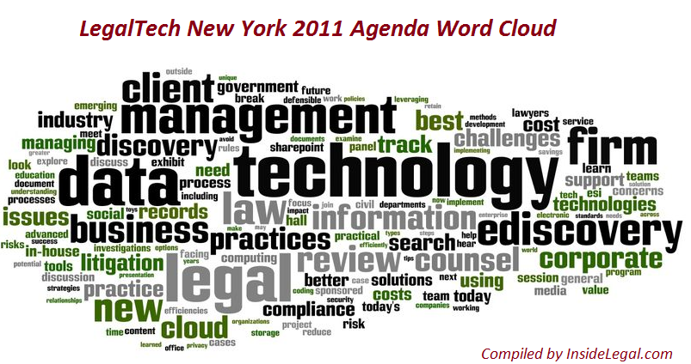
Outline
Outline
Context
Research Stay
FRED tool
Bologna
Rome
Future
Next Steps

Slide 3
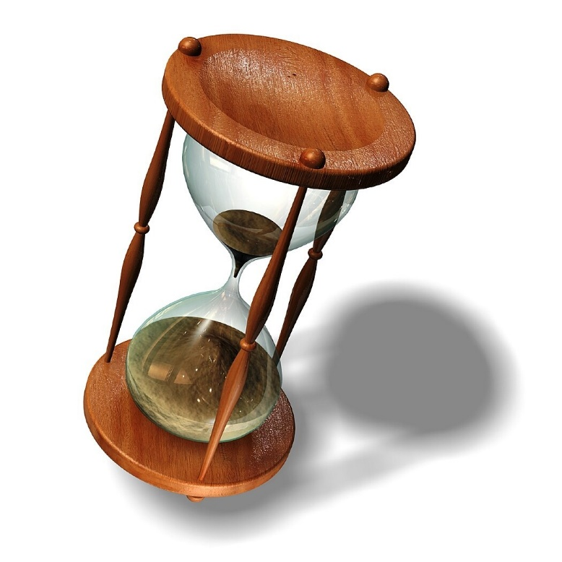
CONTEXT
PhD Thesis

Slide 4
Question 1
Your topic was?
¿Pero tú qué hacías?

Slide 5
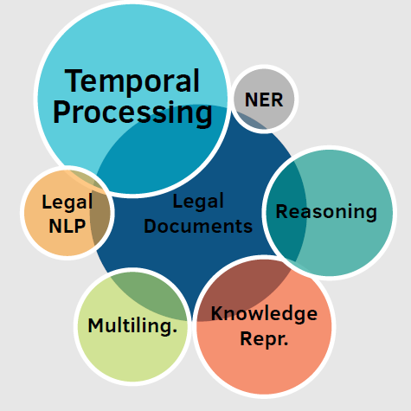
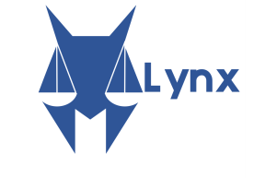
PhD Thesis
Processing, Identification and Representation of Temporal Expressions and Events in Legal Documents
Find and normalize Temporal Expressions (and events),
Represent them,
Do stuff with it! Such as timelines, knowledge graphs…

Slide 6
From text to event representation

Slide 7
From event representation to applications
An event-based representation of judgments would facilitate the understanding of legal documents to both layman and legal practitioners by allowing, among others, the generation of:
Timelines
Event-based summaries
Pattern-based analysis of judgments
Question Answer systems
… and more!

Slide 8
Question 2
…but what have you done?
vale, ¿pero tú qué has hecho?

Slide 9
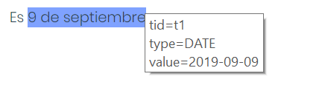
Añotador (main thesis result)
http://annotador.oeg-upm.net/
Añotador is a temporal tagger for Spanish and English. It is able to find and normalize dates, times, durations and sets (temporal expressions that repeat periodically, such as “monthly”, “twice a year” or “every Tuesday”). There is a demo available in its webpage, and can be called as webservice or downloaded from GitHub (where all the code and a docker image are available).
(acc. to LKE2019 / Journal of Intelligent and Fuzzy Systems)

Slide 10
LawORDate
http://legalwhen.appspot.com/
http://ceur-ws.org/Vol-2049/04paper.pdf
LawORDate is a webapp that takes a text with legal references including dates and returns it without them.
Once the temporal tagging is done, the references are restored in the text.
An example: "En la presente base de datos se recogen los elementos inscritos en el registro creado via el Real Decreto 2093/2008, de 19 de diciembre. Ha sido actualizado por ultima vez el 13 de agosto de 2017."

Slide 11
TempCourt (w. WUWien, Austria)
TEMPCOURT
https://tempcourt.github.io/TempCourt/
Corpus of legal documents from three different courts (ECJ, ECHR, USC) annotated using the TimeML standard.
Two sets of annotations: StandardTimeML and LegalTimeML (were just dates related to facts are tagged)
Analysis of particularities with regard to temporal dimensions.
Evaluation of 10 state of the art temporal taggers on legal documents.
(accepted, to be published at KER)

Slide 12
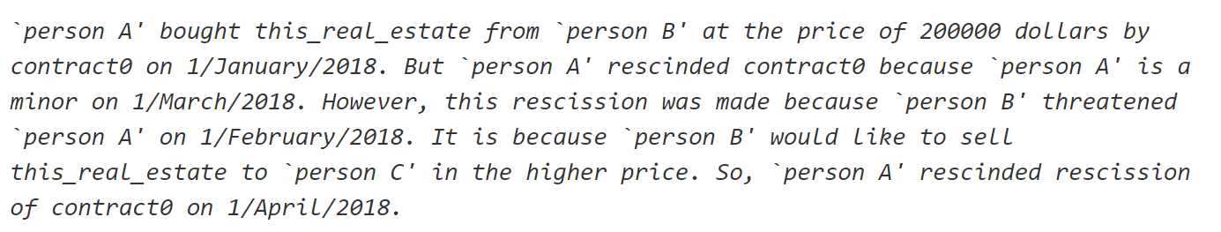
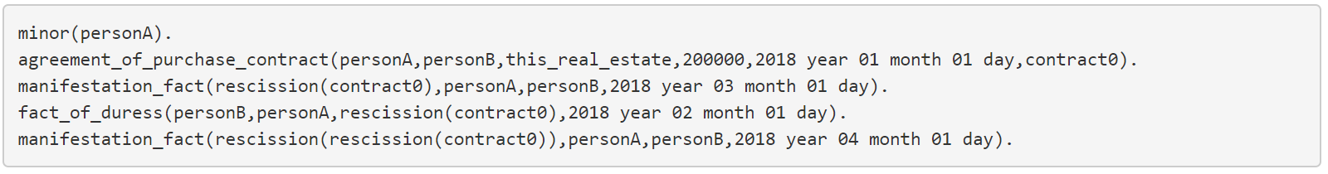
ContractFrames (w. NII, Japan)
https://github.com/mnavasloro/ContractFrames
ContractFrames is a software able to detect some specific contract events in texts. The system represents them as frames that are used to output a PROLEG knowledge base with all the information (it is able to handle coreference to some extent).
(JURISIN 2018)

Slide 13
Question 3
…is it somewhere, is there something I can use?
¿pero hay algo que me sirva a mí de eso?

Slide 14
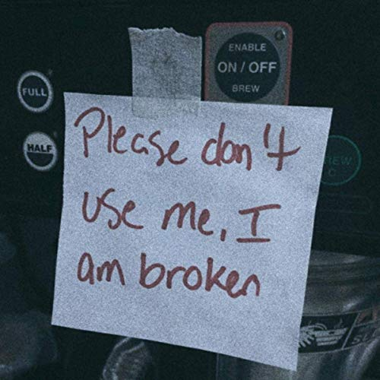
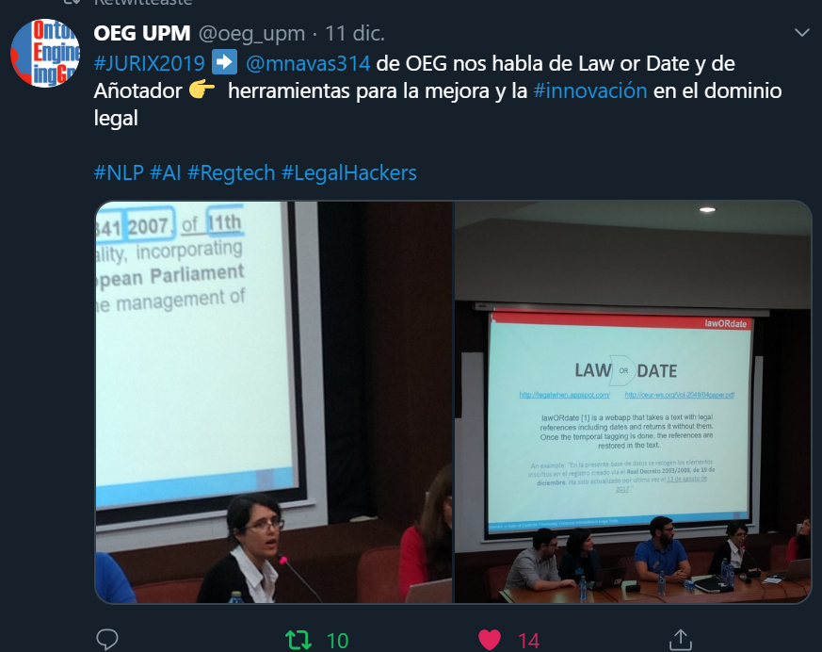
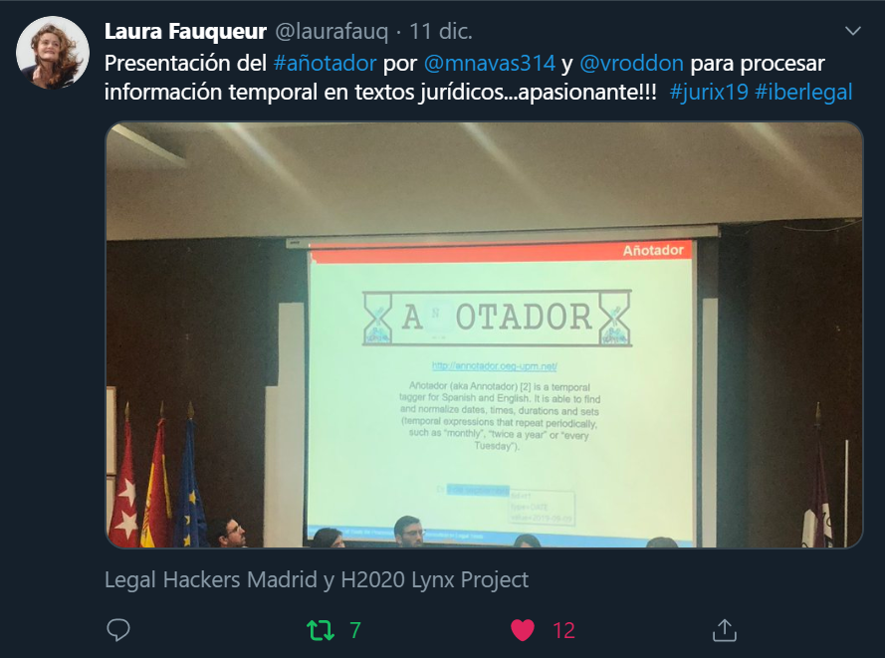
We have it good, beautiful and cheap
Everything on GitHub, some also:
Websites
Webservices
Docker
Any help for mavenizing is welcome ☺
Ask me any doubt.
Cite me a lot.
Join to the happy users already enjoying my software!
Lynx
Mariano

Slide 15
Question 4
…are you free now to…?
¿estás libre para…?

Slide 16
Good question!
YES
Please let me know any interest in collaboration.
Focused on temporal information.
Better if reuses or adapts somehow what I already did/am doing.
NO
I should be writing the thesis.
I have ongoing collaborations I have to “close” before defending.
Really, I should keep on writing.
So try to keep it related ☺

Slide 17
Question 5
…when do you defend?
¿cuándo defiendes?

Slide 18
Time Party Time!
Next year!
…if everything goes as expected…

Slide 19
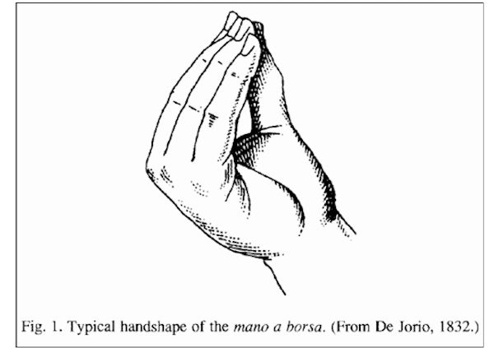
Research stay
STLab - Italy

Slide 20
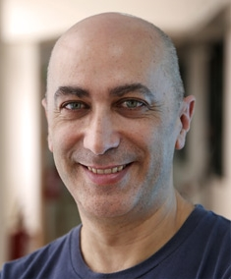
Research stay introduction
Three months at STLab
02/09-11/10/2019 – UNIBO (Bologna)
14/10-02/12/2019 – CNR-ISCT (Rome)
Worked mainly with Aldo Gangemi using FRED.
Abstract Objective: event extraction in the legal domain.

Slide 21
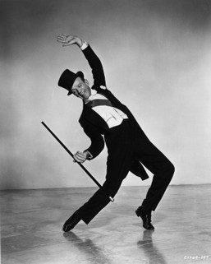
FRED
Research Stay

Slide 22
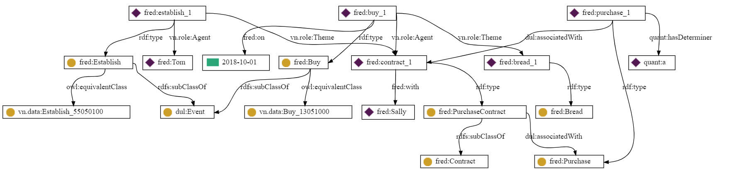
Tom established a purchase contract with Sally to buy bread on October 1 2018.
FRED who?
FRED is a tool that transforms Natural Language into RDF/OWL ontologies and linked data.

Slide 23
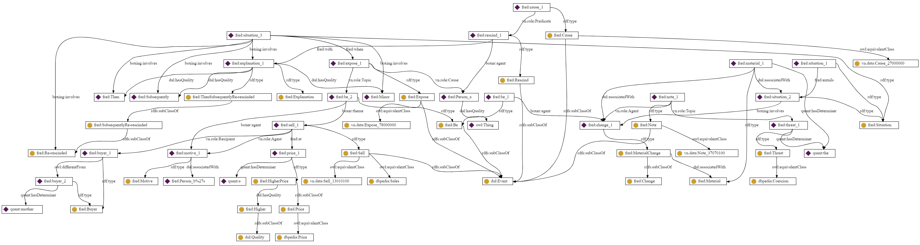
The only material change is to note the threat causing Person A to rescind with explanation of being a minor, but then subsequently re-rescinded when it was exposed that Person B’s motive was to sell to another buyer at a higher price.
FRED “life is tough” example

Slide 24
Steps
FRED did not work very well in legal texts.
Let’s download and preprocess judgments and see how it behaves.
So steps:
Choose a source suitable
Do the preprocessing needed
Decide the data structure and send it to FRED
Check the result and improve if posible with preprocessing
See the output of FRED and decide how to proceed. Ideas:
Is there any inner structure in judgments we can exploit?
Can we retrieve events from FRED’s output?
Source
Preprocessing
Structure
Improvement
?
Usability

Slide 25
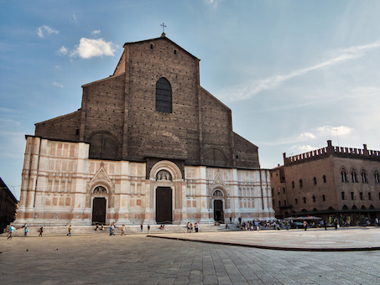
BOLOGNA
Research Stay

Slide 26
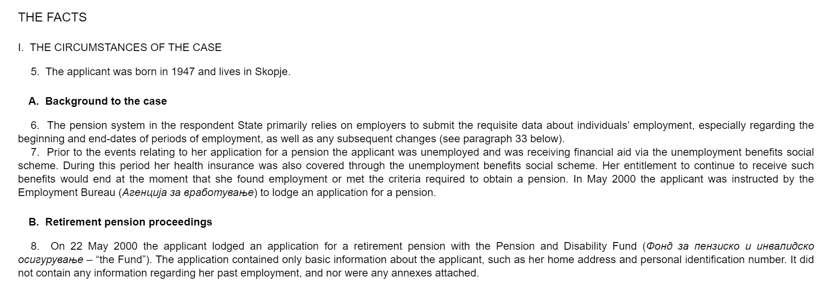
1. Choose source
After some shopping around, we chose ECHR and download a bunch of documents.
We sent them to FRED and checked the result.
We detected some problems (X., keeping structure, several levels, foreign expressions, long sentences…)

Slide 27
2. Preprocessing
Based on a previous code by Víctor, we code some Structure Extractor for this kind of document. We extract:
Raw text (no X.s, bullet points, weird symbols…)
Type (paragraph, title…)
Hierarchy (parent, depth)

Slide 28
3. Structure and send to FRED
We decide to do one named graph per paragraph, keeping for each title and parent as metadata.
Andrea Nuzzolese provides a script that takes a CSV file with relations and text and sends them to FRED…
?

Slide 29
4. Improvement
FRED presented some problems with complex structures frequent in the legal domain, so more preprocessing was needed.
We preprocessed iteratively the input to make it “easier” to FRED, and we finally got acceptable results.
a

Slide 30
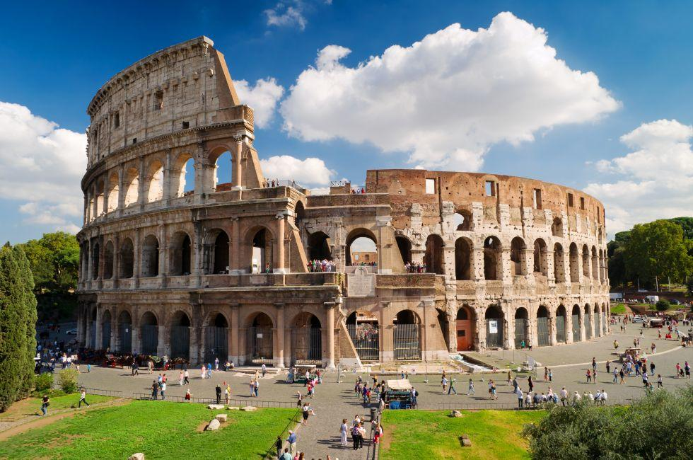
ROME
Research Stay

Slide 31
5. Usability
So we have about 200 judgments in the form of sets of named graphs, with some hierarchical metadata.
We input it to Virtuoso and Blazegraph to start playing…
From the two lines of research previously discussed, I of course started with events ☺
Aldo Gangemi provides some queries to “detect most verbal events”
I start exploring both how to detect these events and temporal expressions…
Funnily, it works more or less nice for events (acceptable precission, bad recall) but not for temporal expressions!

Slide 32
5. Usability
It is not possible to input annotations to FRED ☹
But there is someone working on it.
In the meanwhile, I will try to:
Perfect the queries to detect events.
Detect the relations (so context information) that are relevant in the legal domain (e.g., the jurisdiction).
Besides this event line…

Slide 33
6. ?
We have a very nice repository of “clean” judgments ready to play with.
Our structured data.
Also in the form of named graphs of FRED.
Anyone wants to come to play with it?
Ideas to exploit it?
Please don’t be shy!

Slide 34
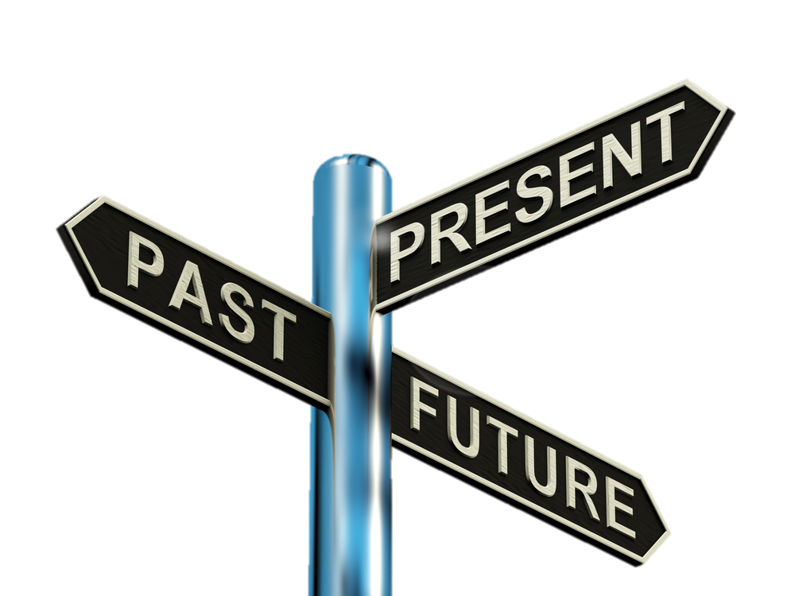
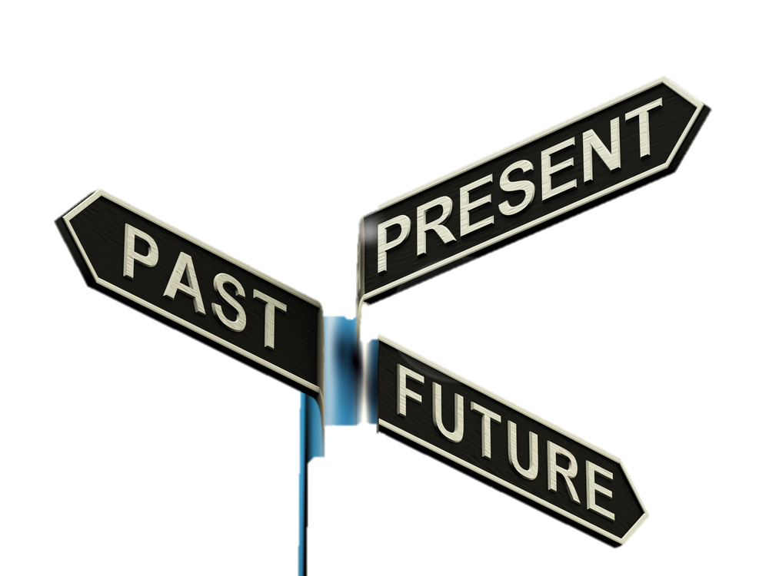
CONCLUSIONS
Future work

Slide 35
Conclusions and Future Work
From the research stay:
A lot of judgments parsed and in the form of named graphs.
We are exploring:
Legal events.
Merging with Añotador.
Current/future work (besides this):
Write the thesis ☺.
Finish ongoing work on legal events (another approach).
Lynx duties.
Publish legal English results of Añotador.

Slide 36
PhD Thesis:
Research stay at STLab
and next steps
María Navas-Loro
Ontology Engineering Group
Universidad Politécnica de Madrid, Spain
mnavas@fi.upm.es
https://marianavas.oeg-upm.net
19/12/2019
OEG
@

